Slide 1



Cloud Topics Part I
burt.walsh@ast.myflorida.com
michael.avello@ast.myflorida.com
August 28, 2018

Slide 2

Presentation Overview
Cloud Topics
Code Concepts
Sample .NET Application
Provisioning in the Cloud
Moving the .NET Application to the Cloud
Serverless Computing and Cloud Paradigm
Code reuse and microservices

Slide 3
Asynchronous I/O and REST

Slide 4
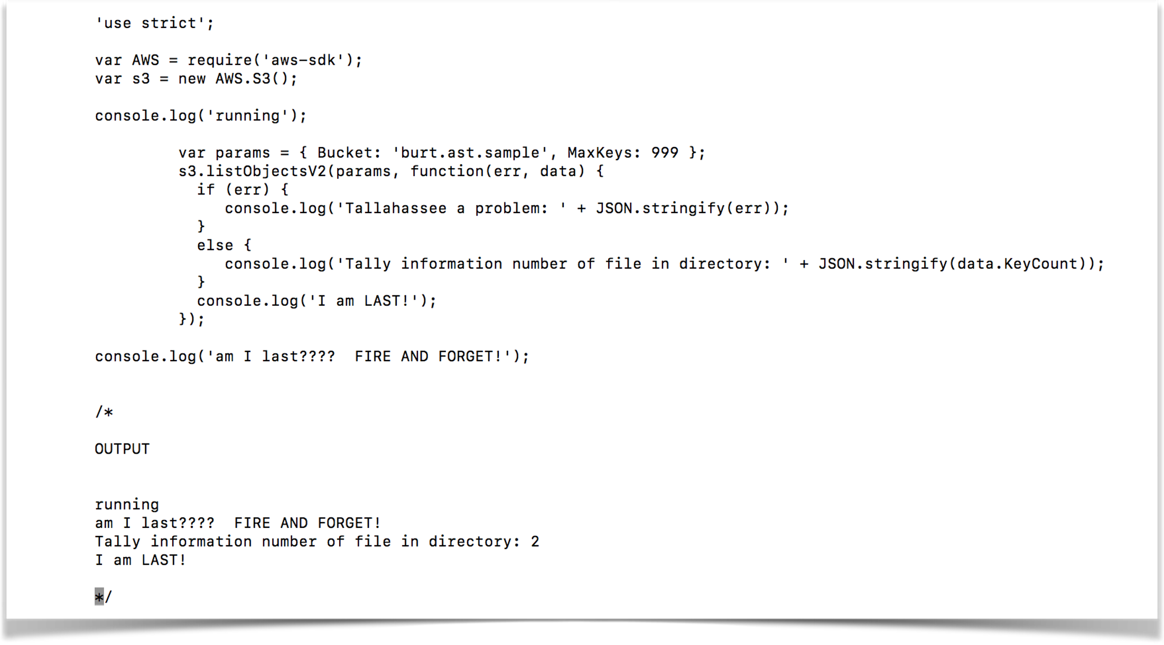
Asynchronous I/O

Slide 5
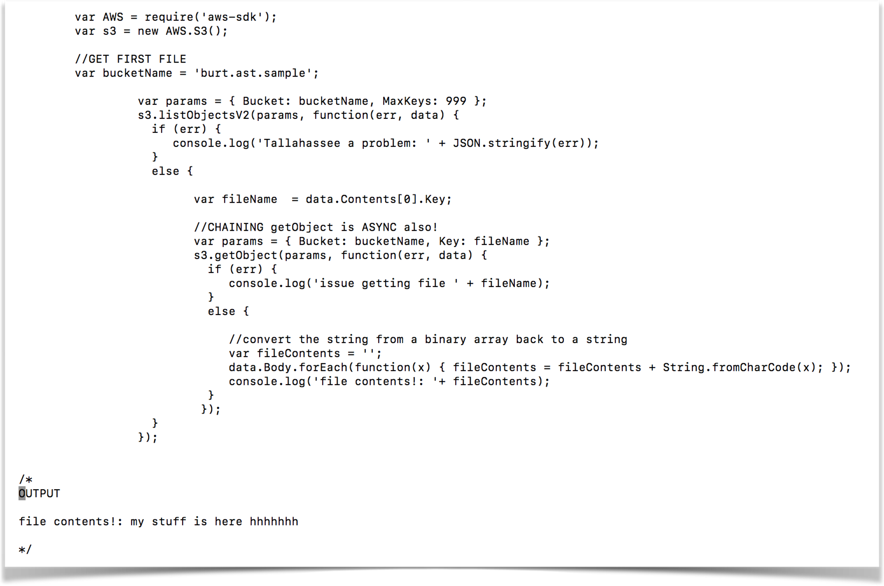
Asynchronous I/O

Slide 6
Chaining Callbacks

Slide 7
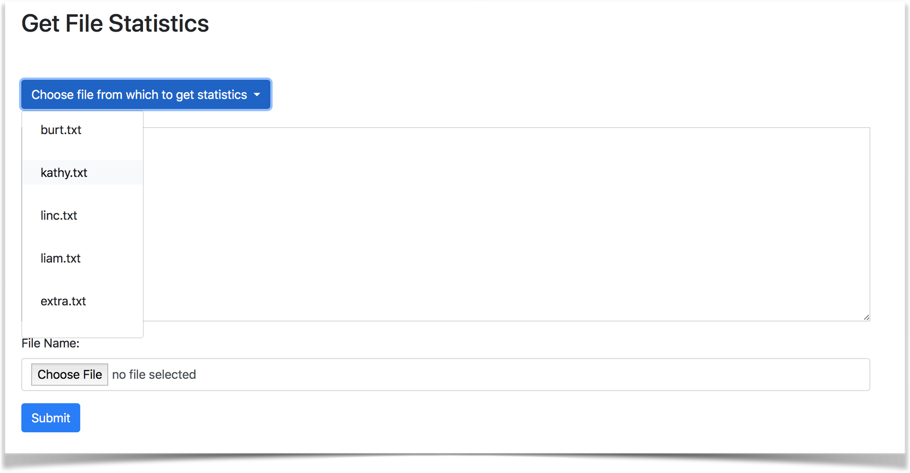

Slide 8
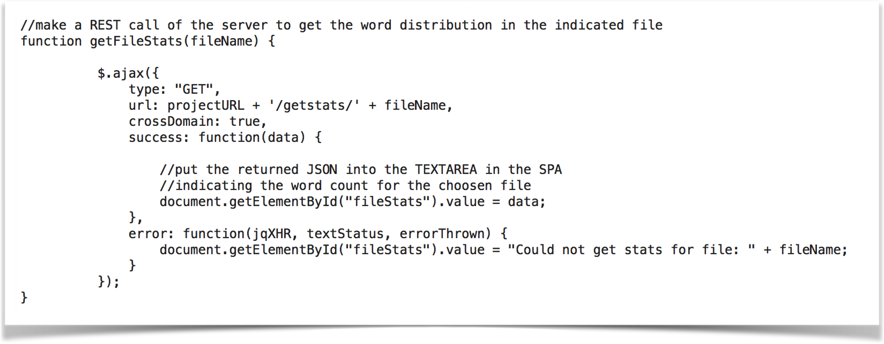
REST Call

Slide 9
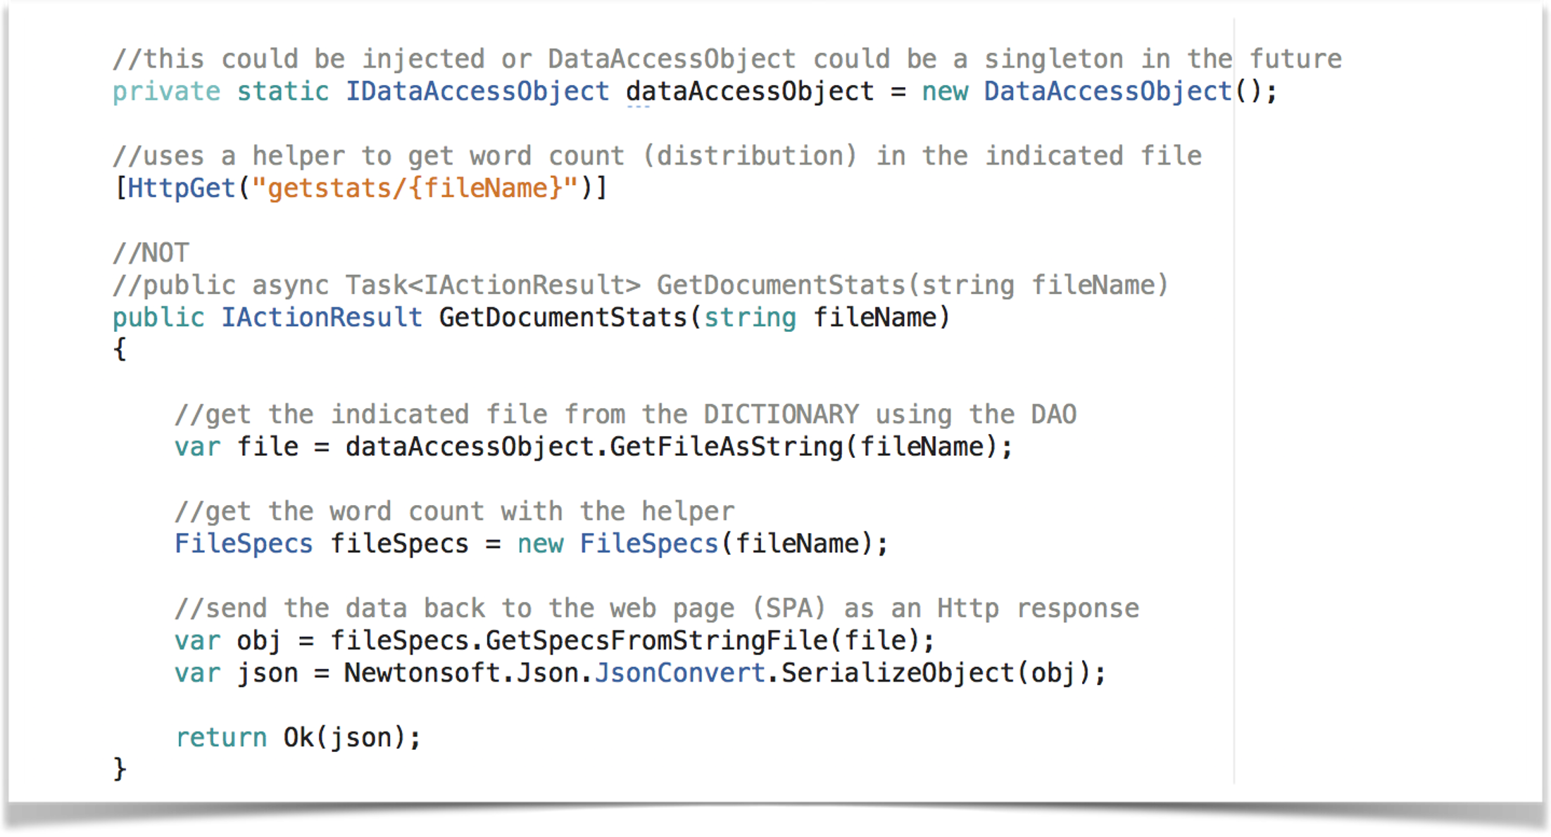
DataAccessObject

Slide 10
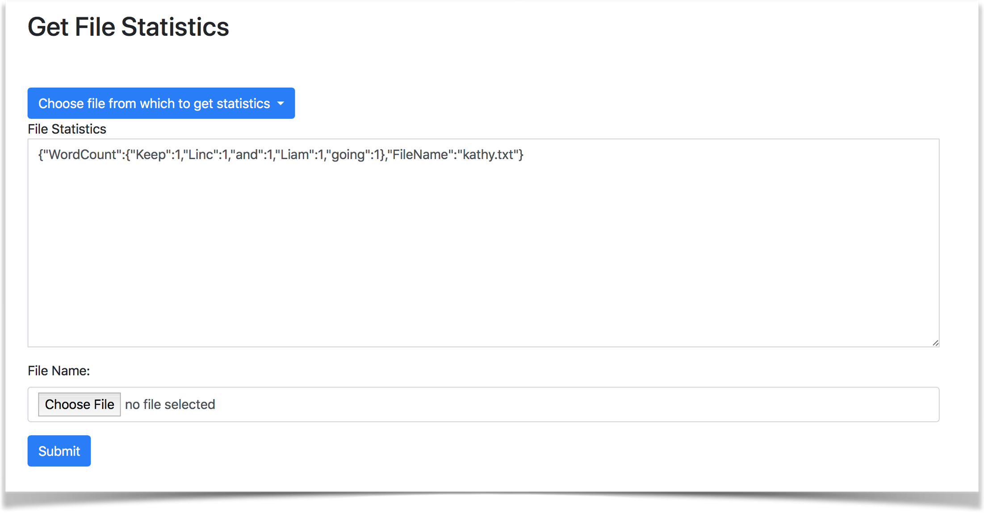

Slide 11
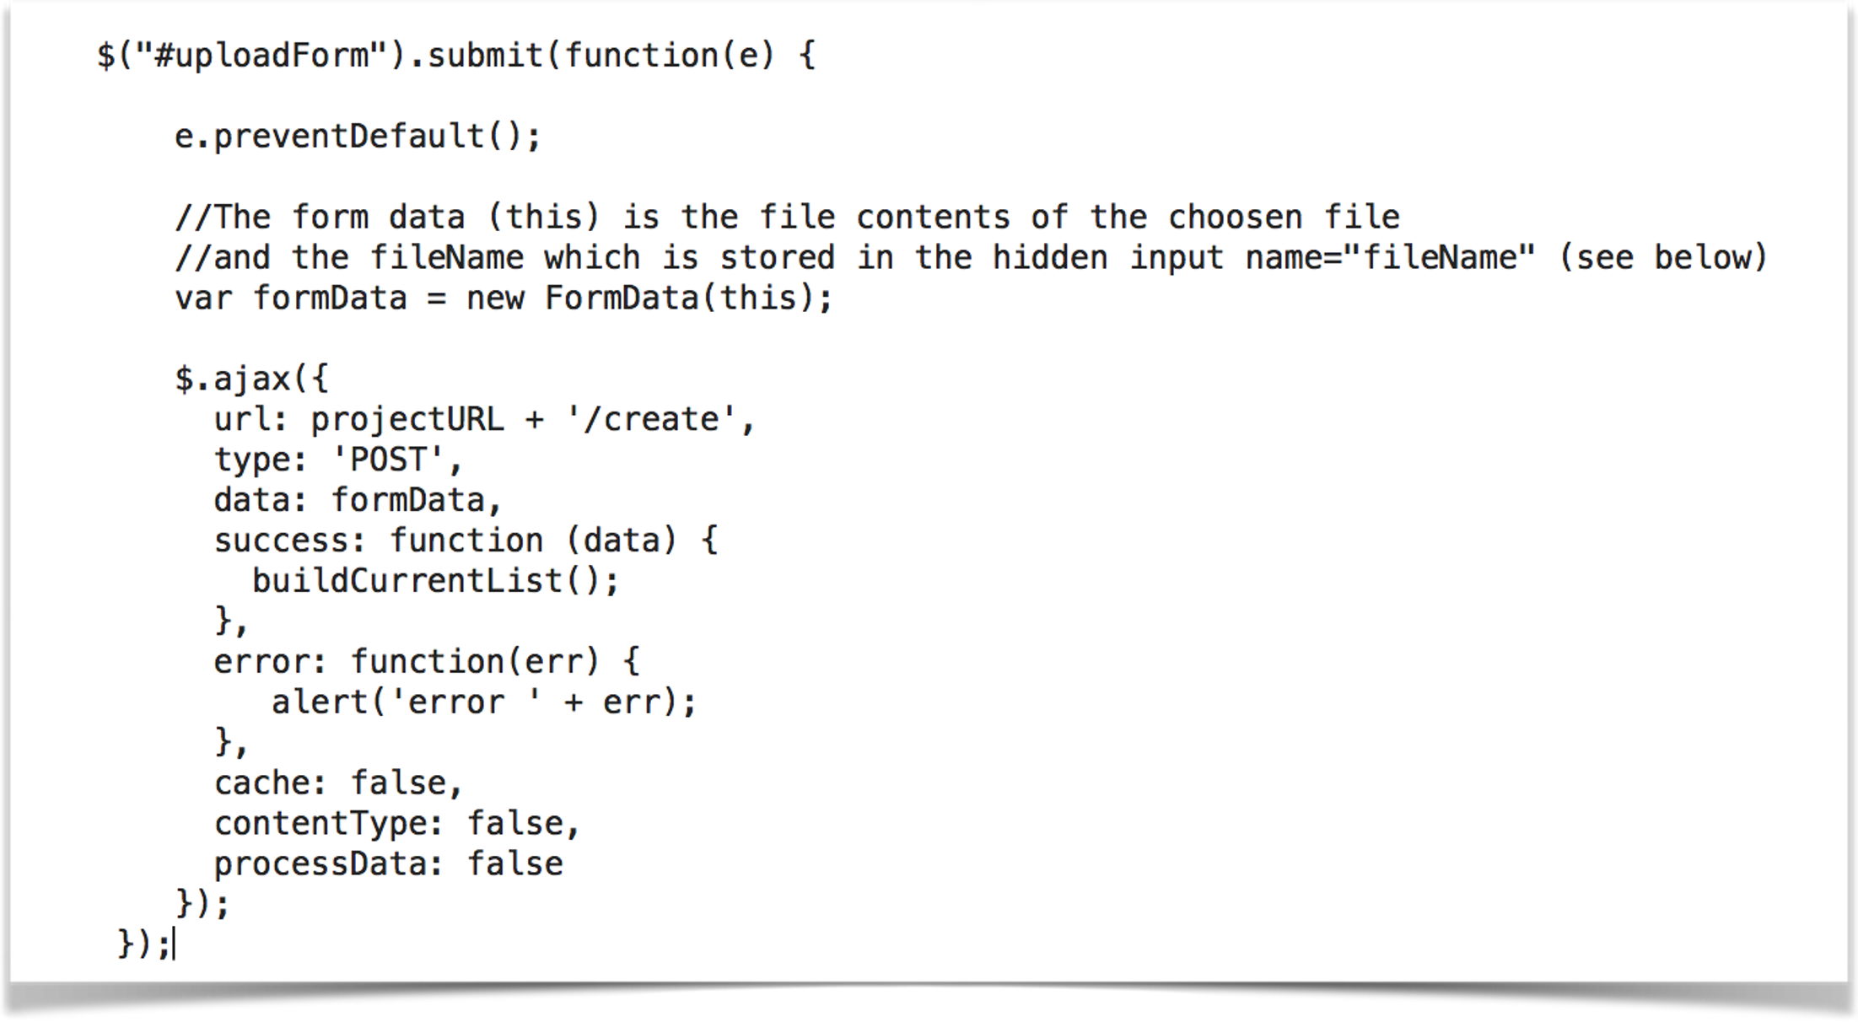
Form Upload Function

Slide 12
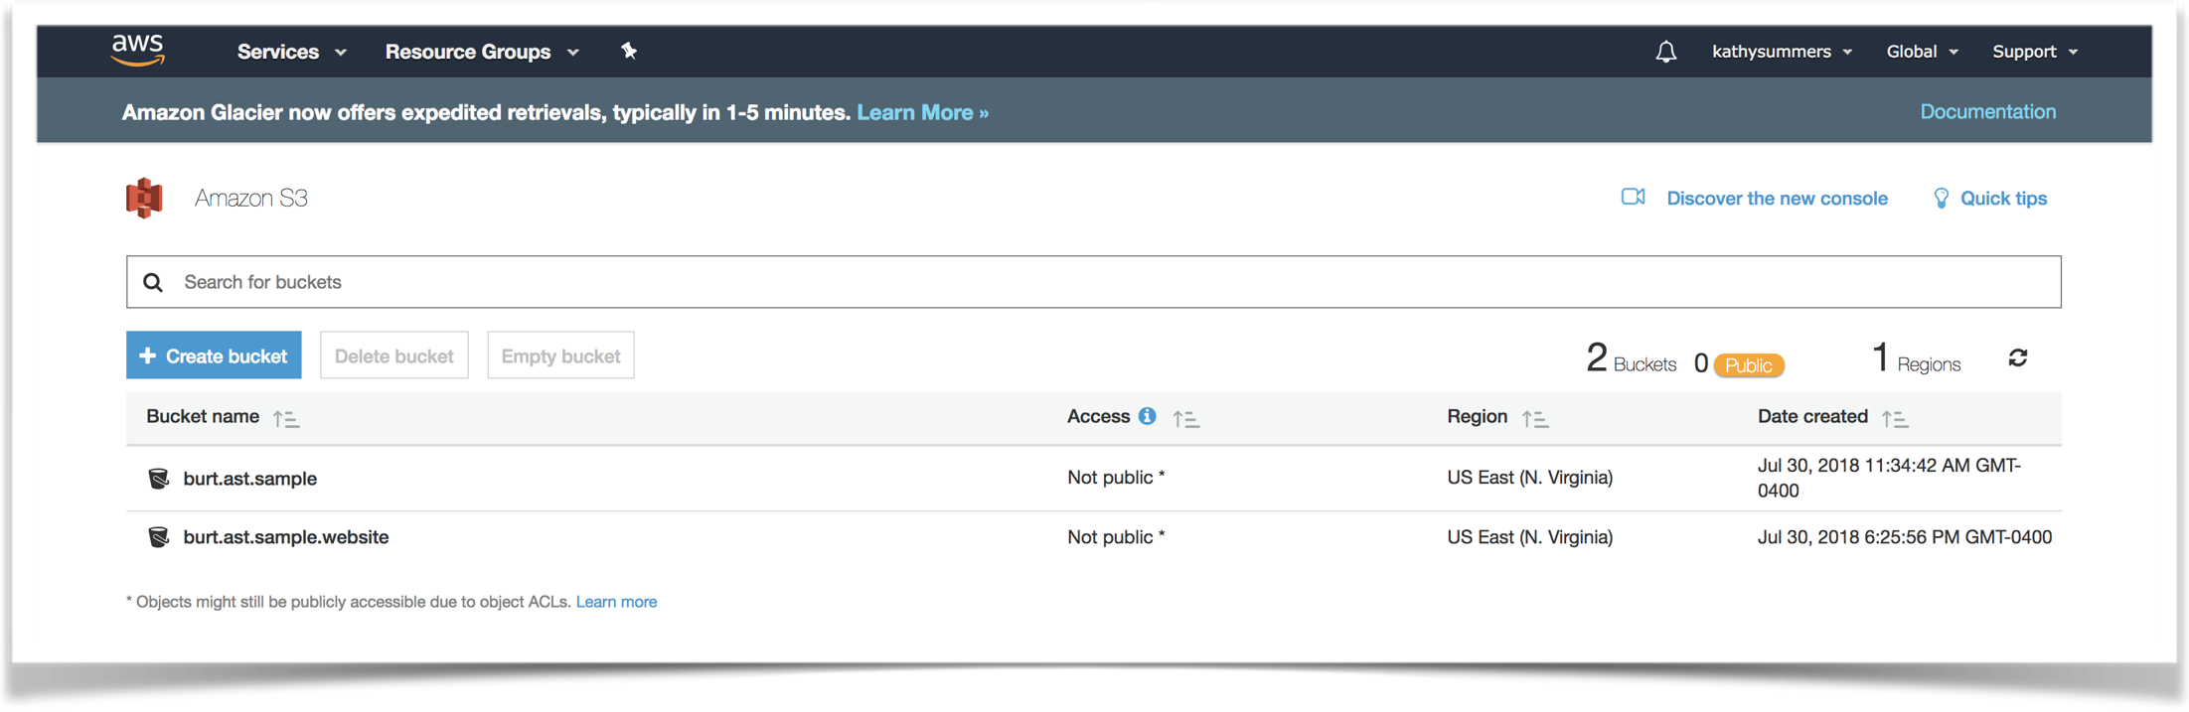
AWS S3 Buckets (Data Object Storage Volumes)

Slide 13
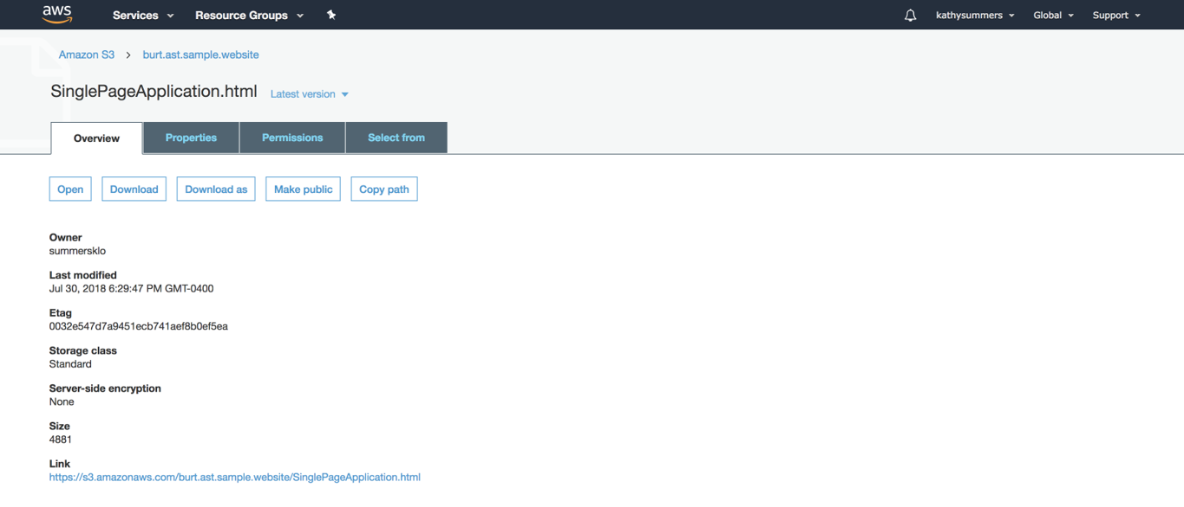
Single Page Application HTML File on S3

Slide 14
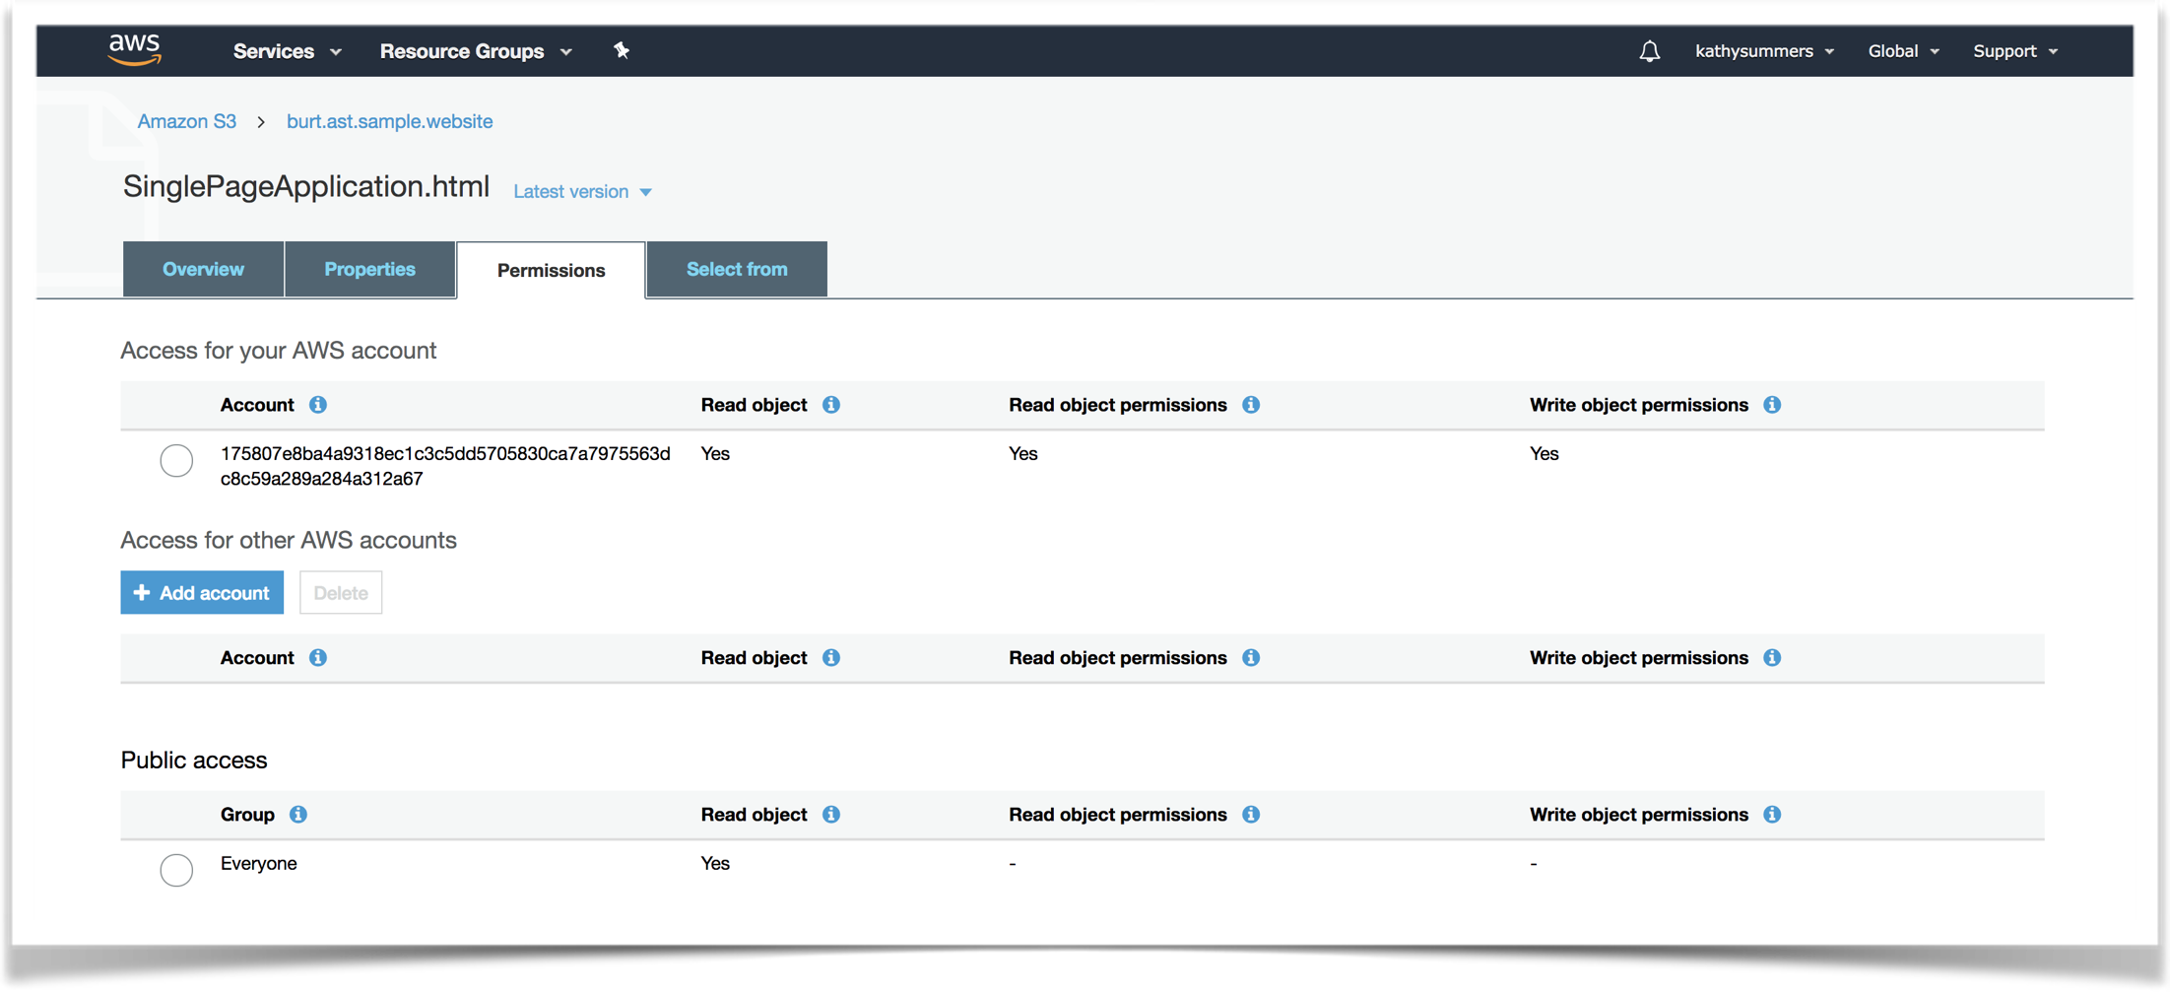
File Permissions on S3

Slide 15
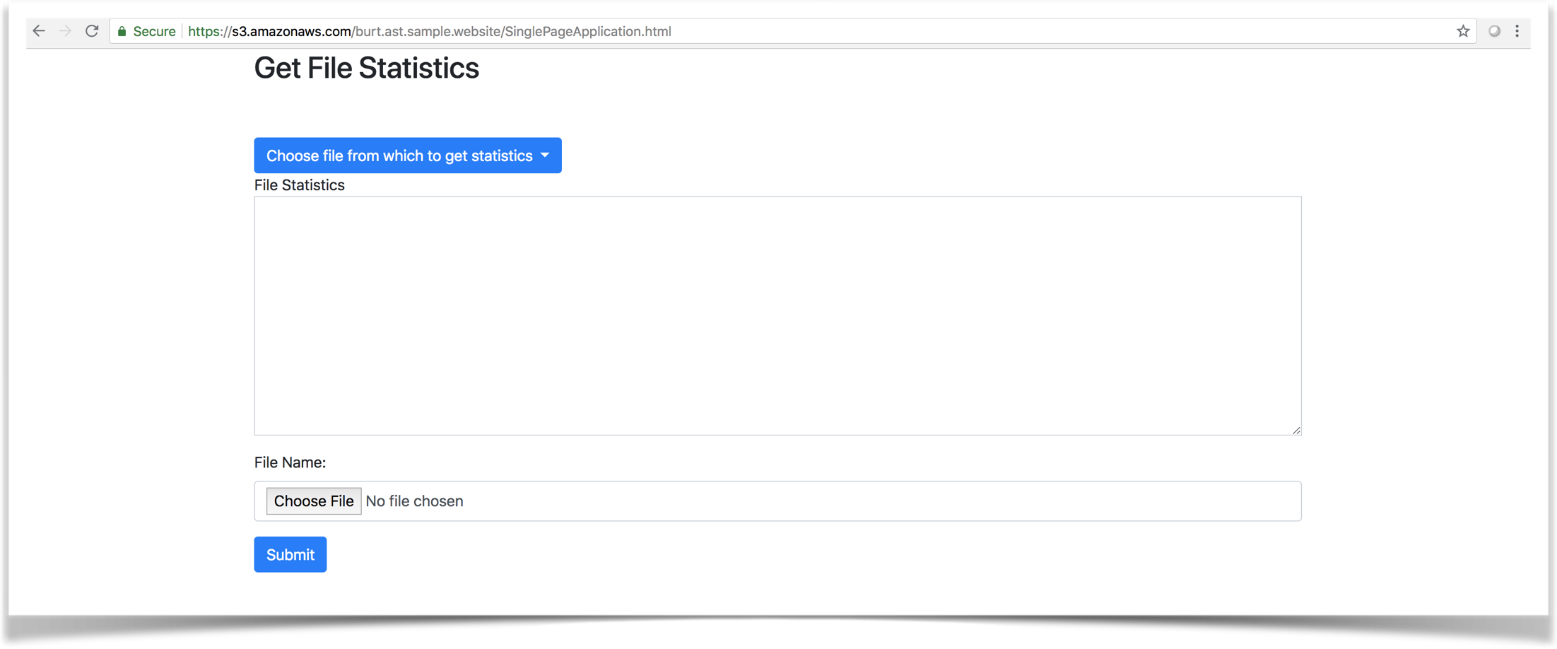
Single Page Application UI

Slide 16
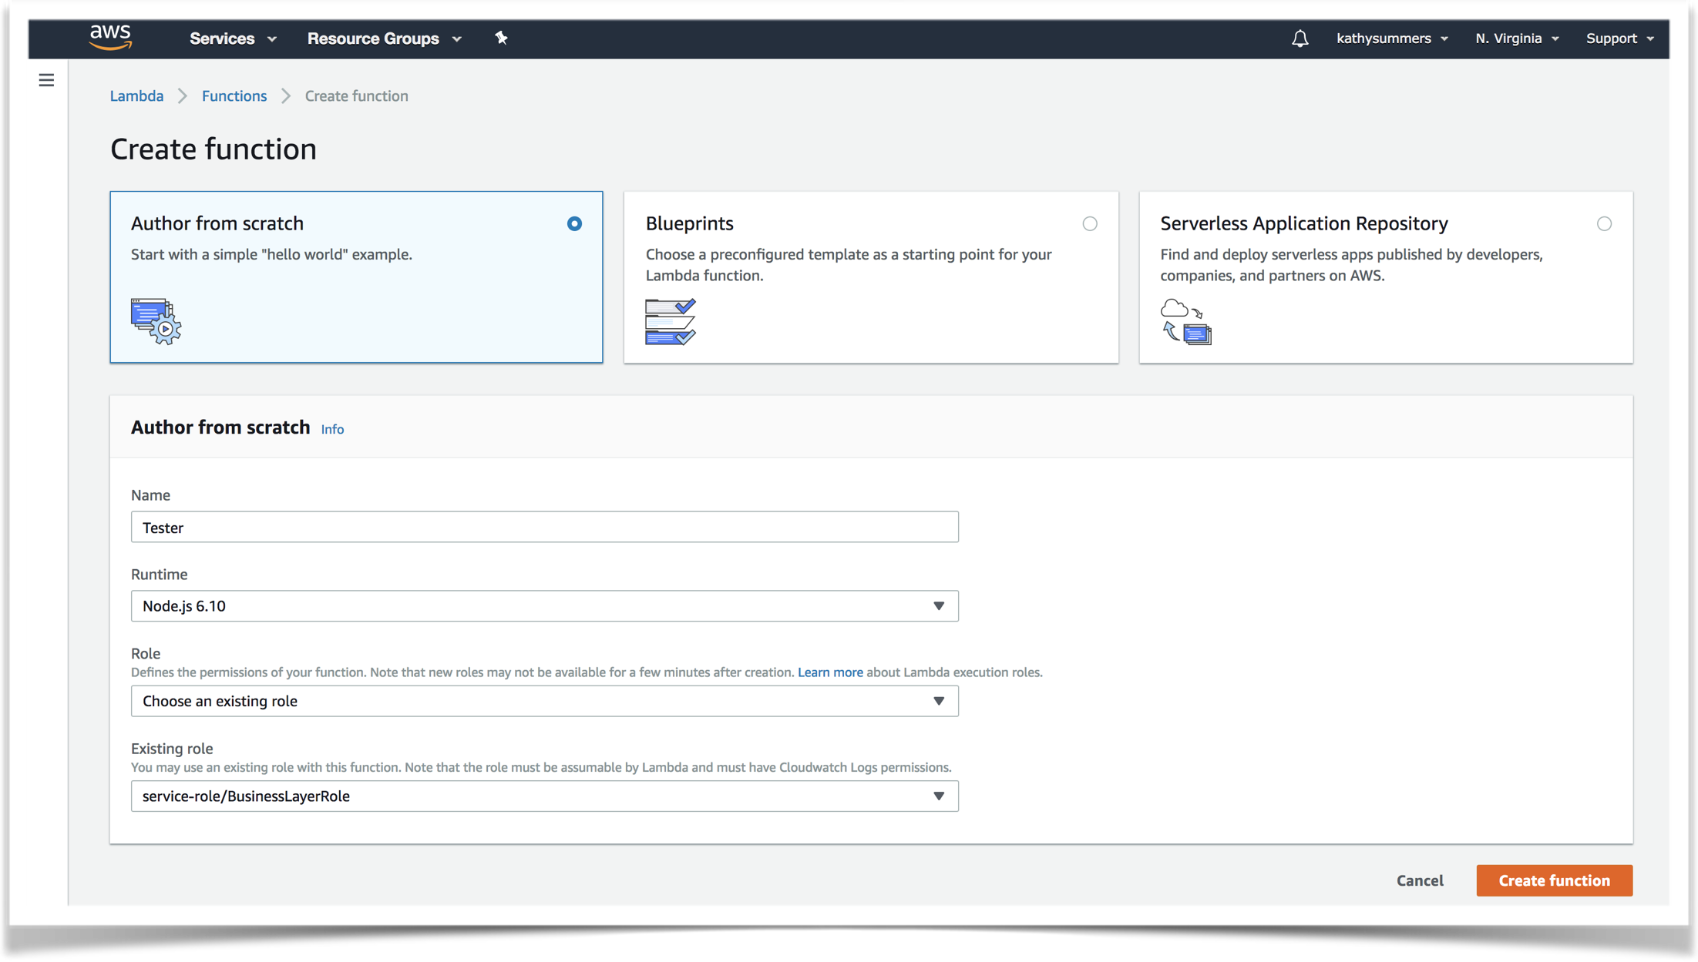

Slide 17
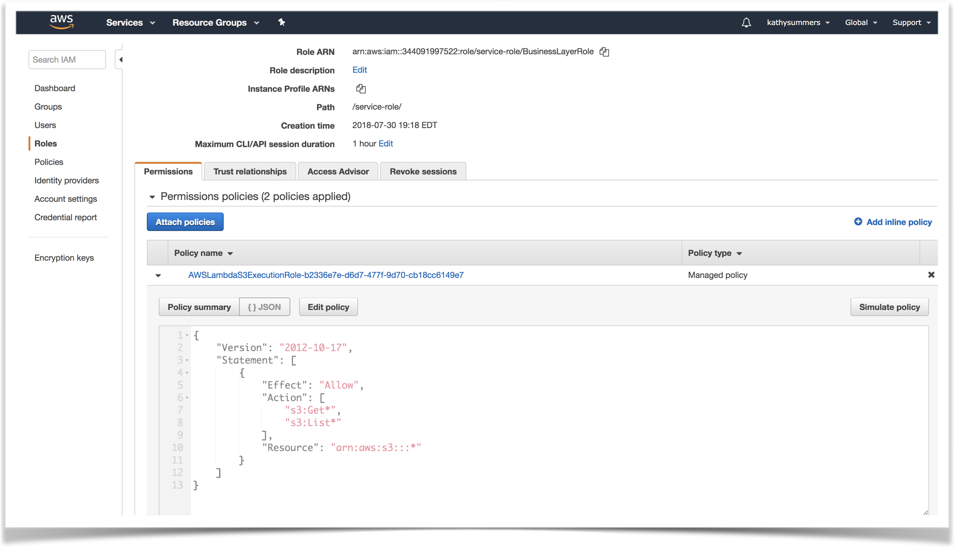

Slide 18
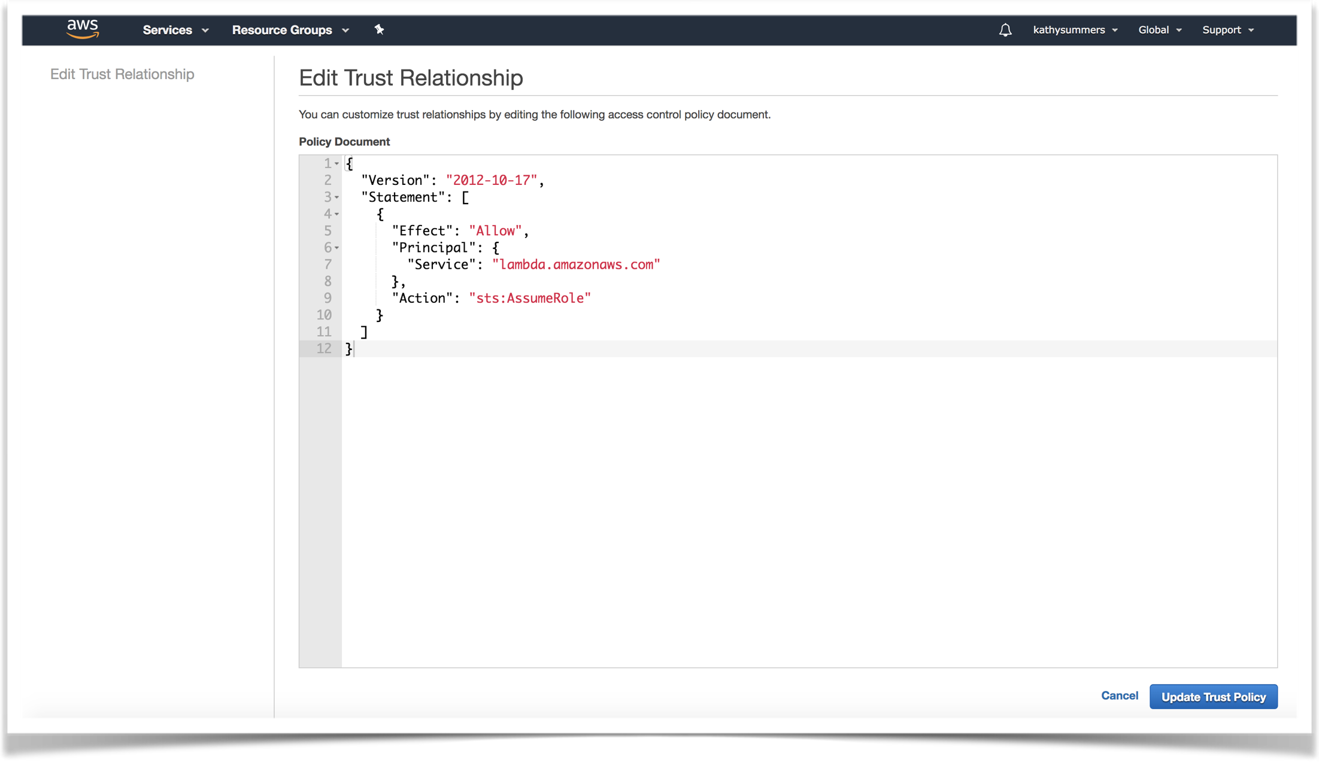

Slide 19
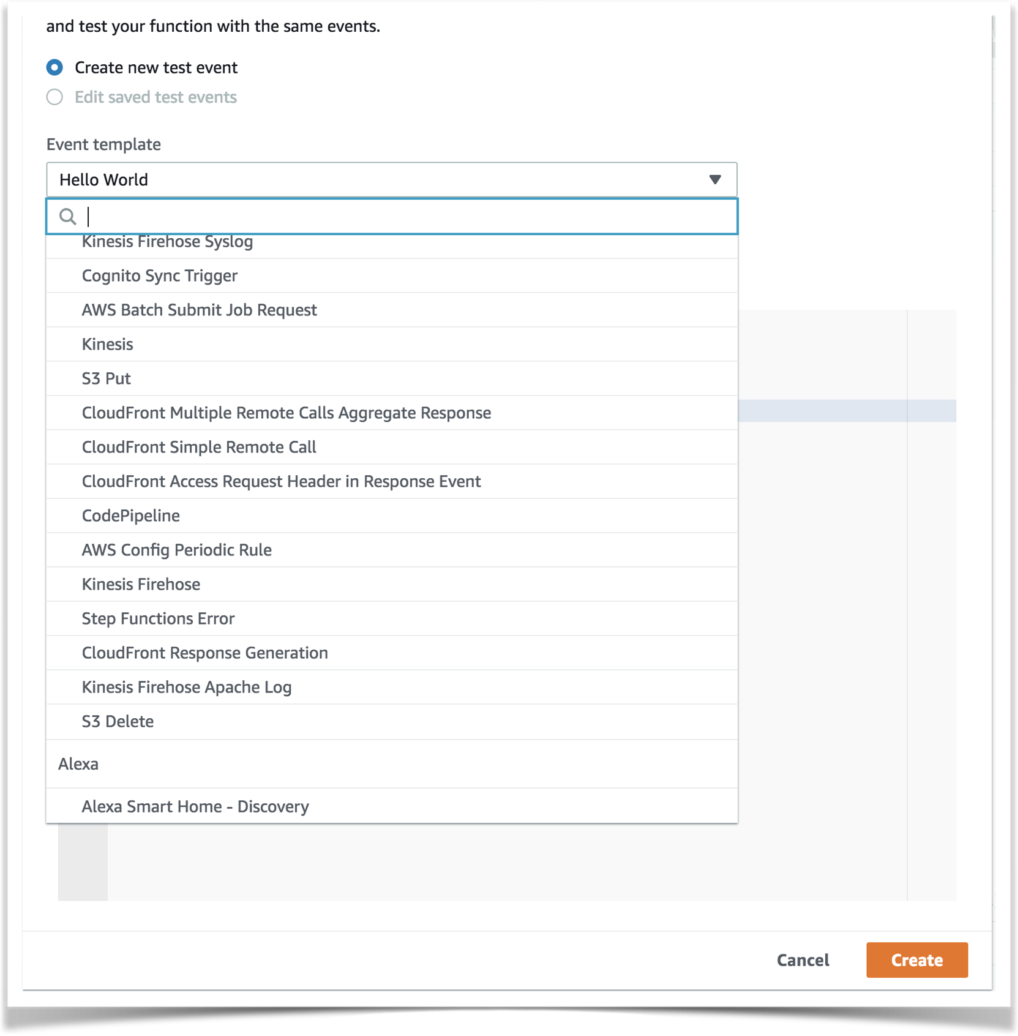

Slide 20
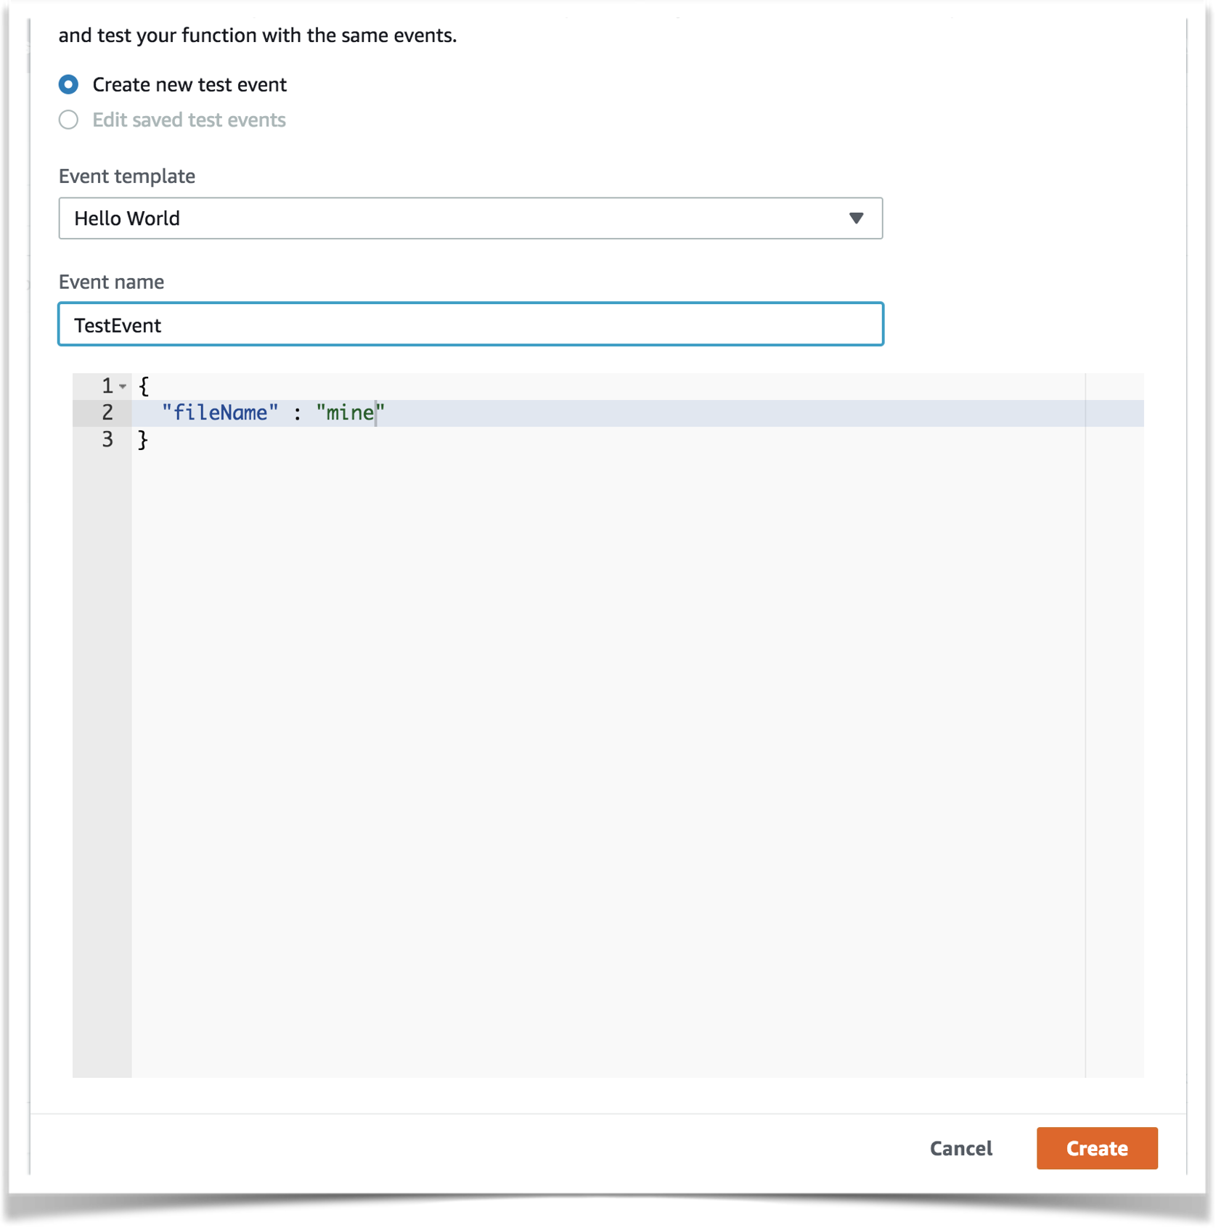

Slide 21
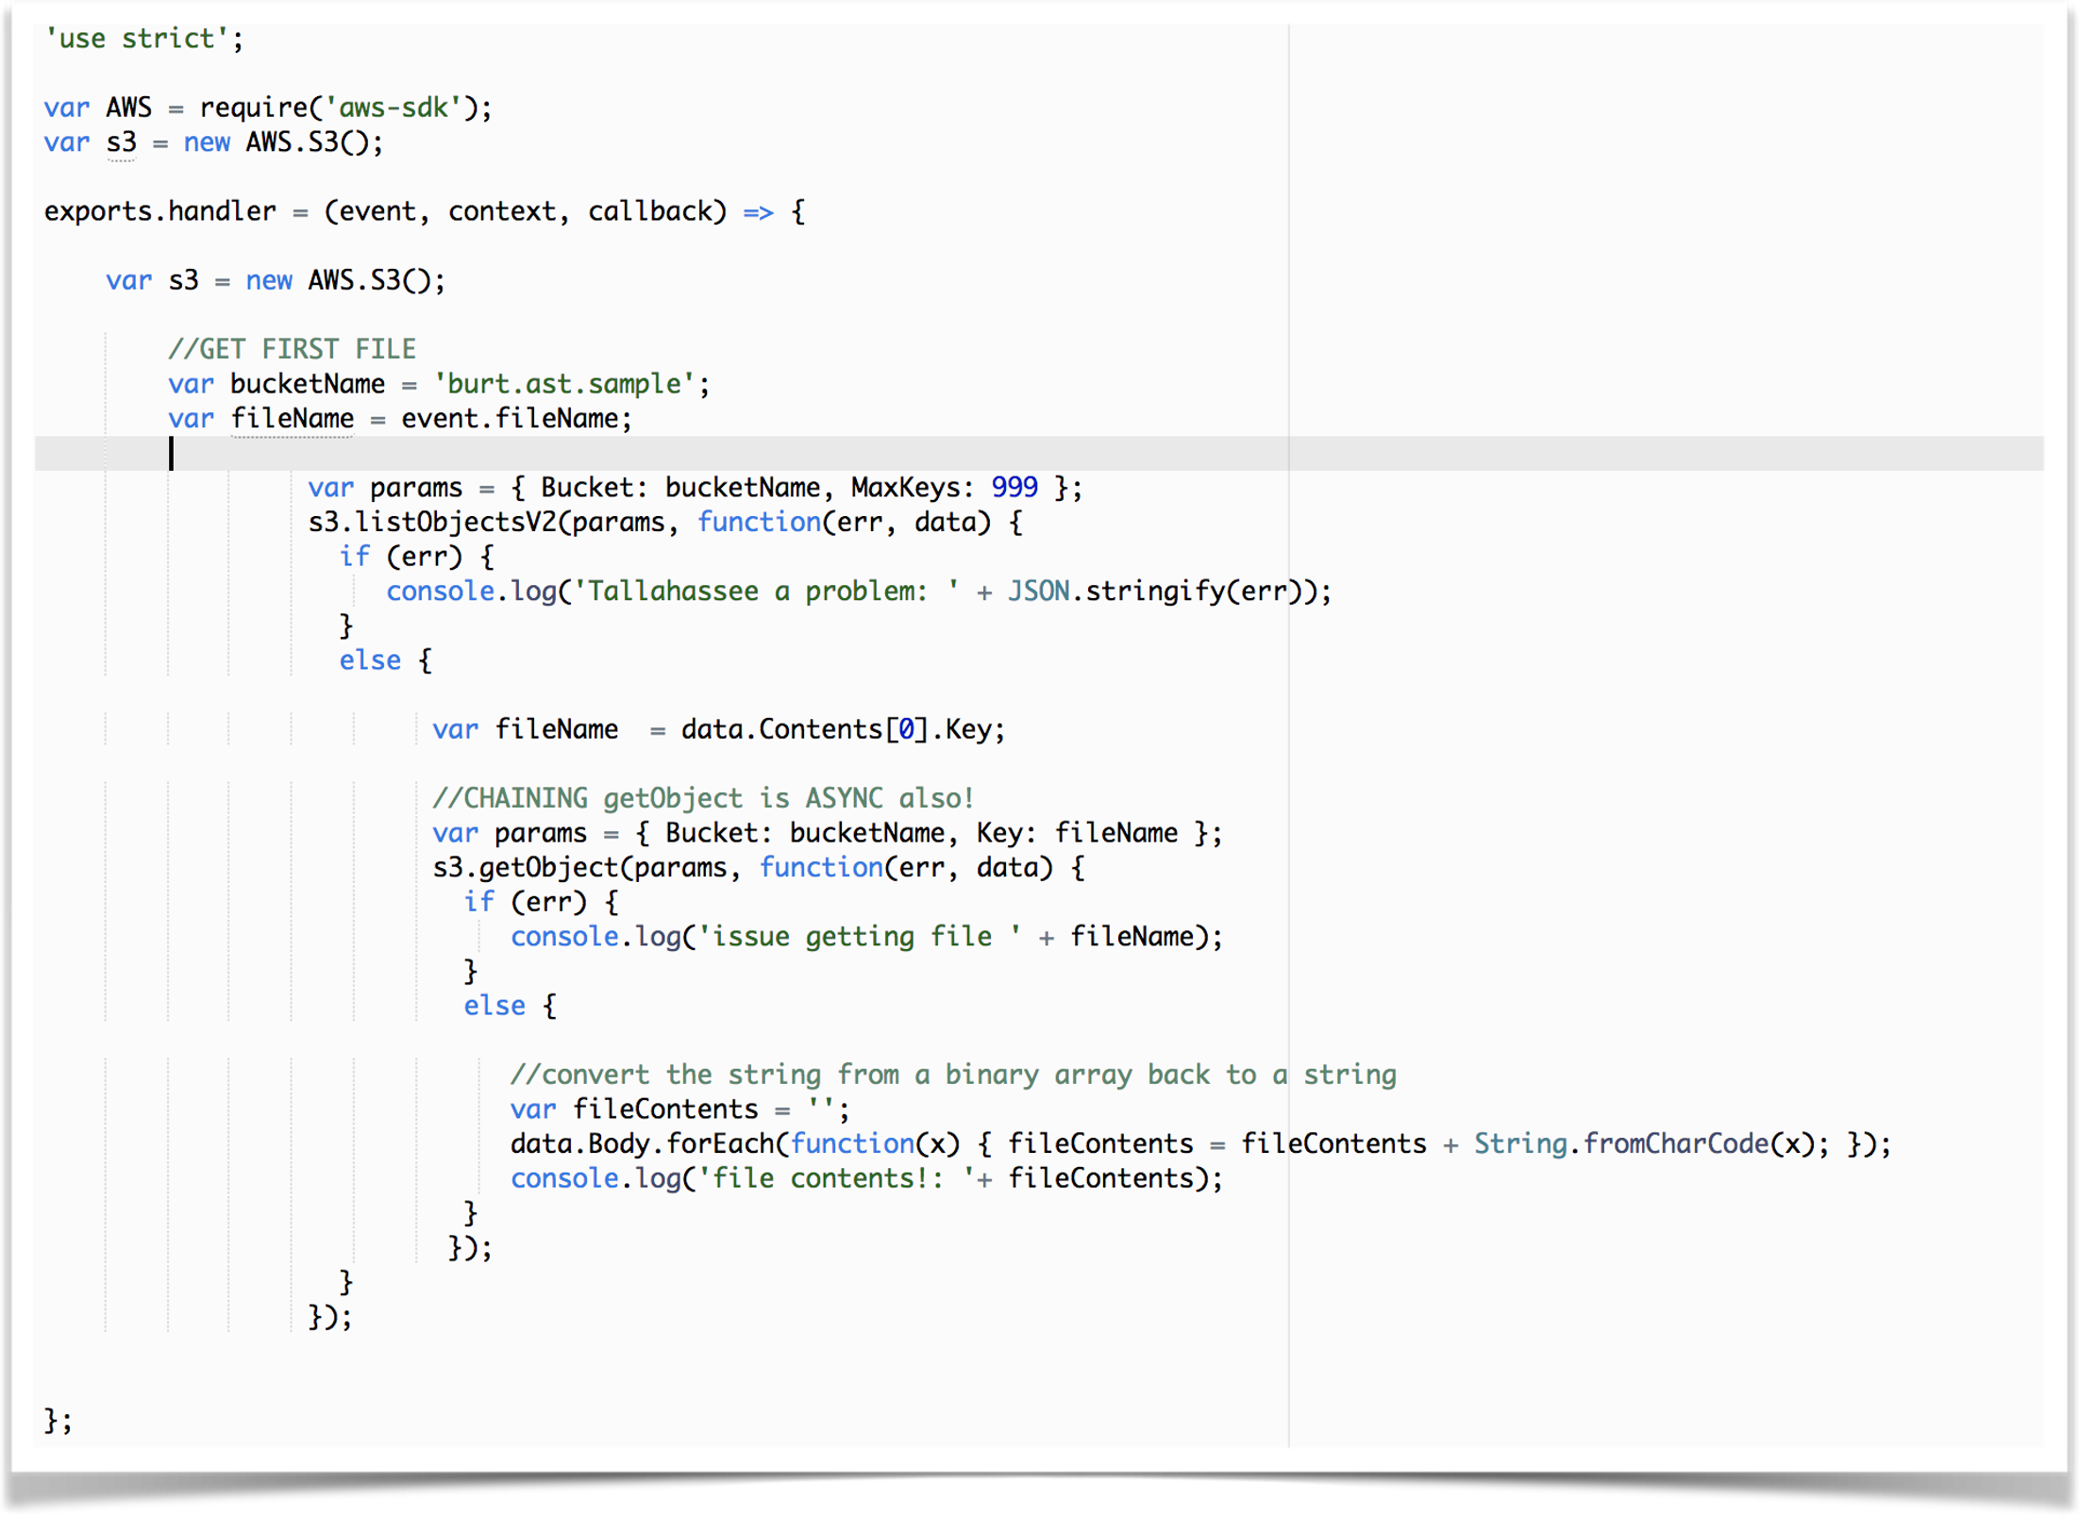
Chaining Callbacks

Slide 22
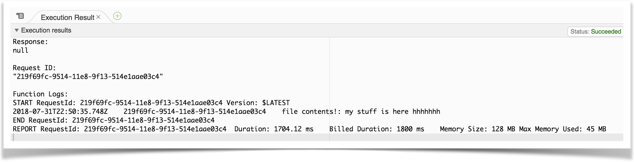
Test Event Execution Results

Slide 23
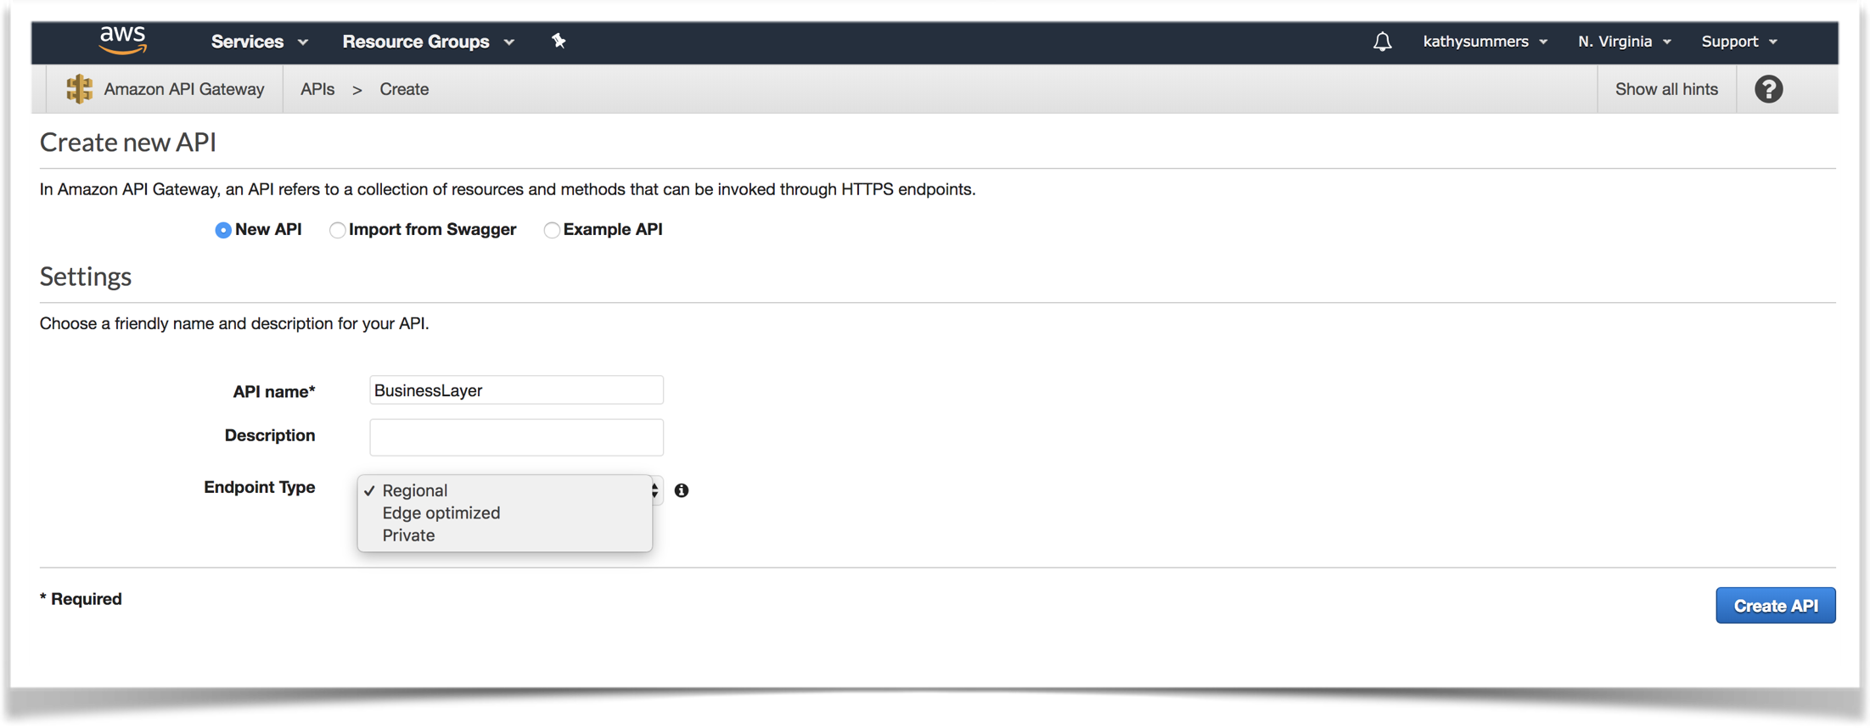
API Gateway

Slide 24
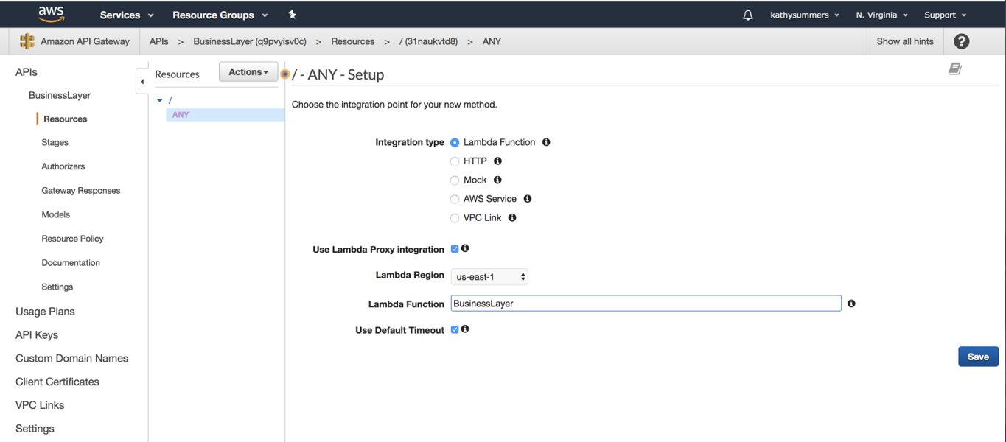
API ANY Setup

Slide 25
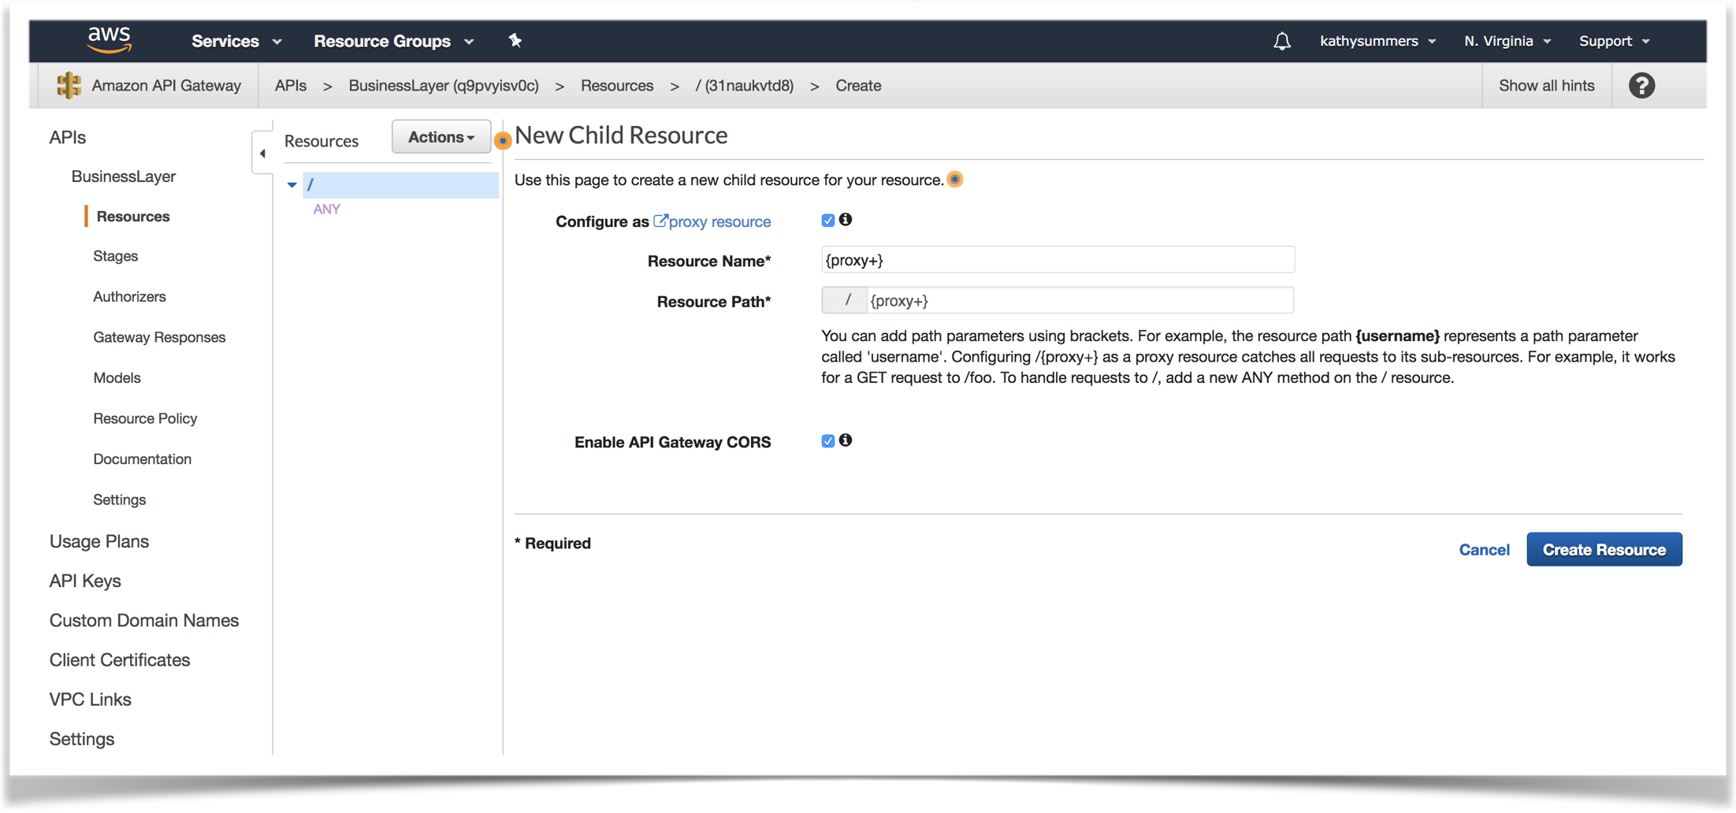
API Proxy Setup

Slide 26
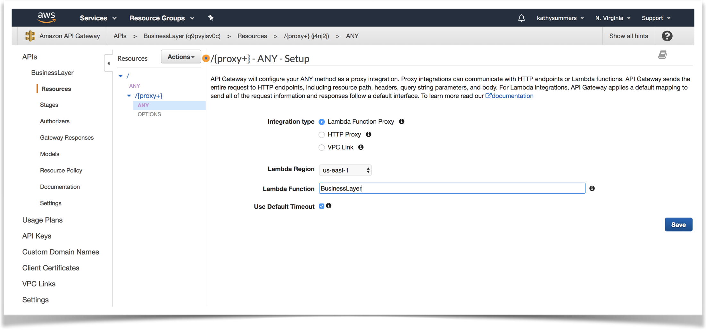
API ANY Proxy Setup

Slide 27
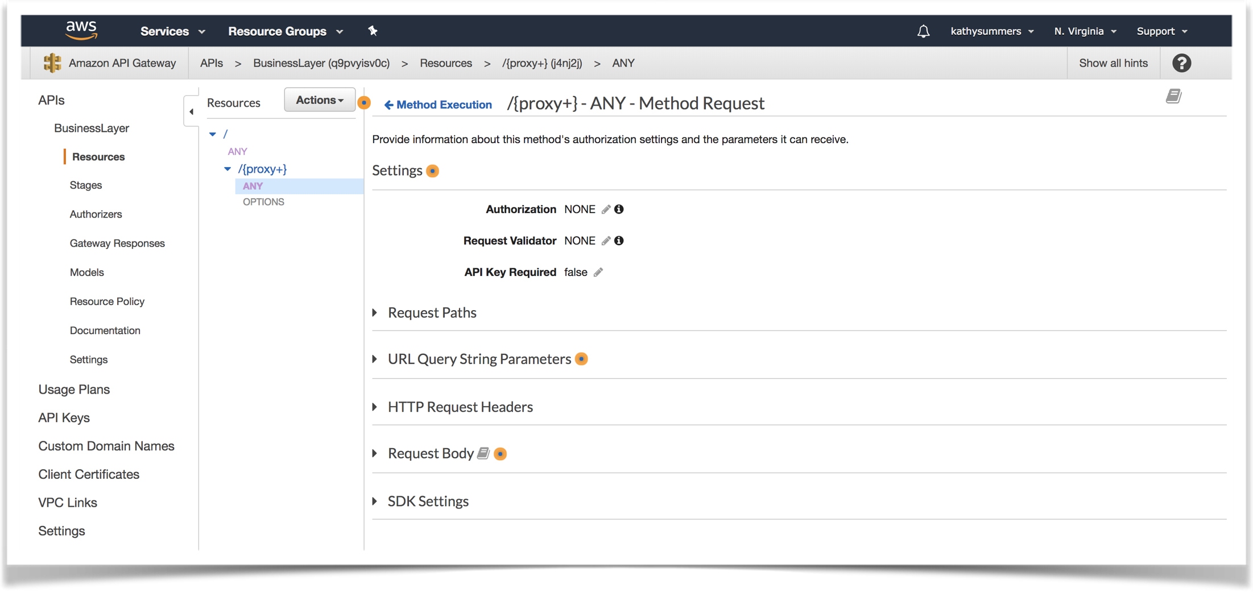
API Proxy ANY Method Request

Slide 28
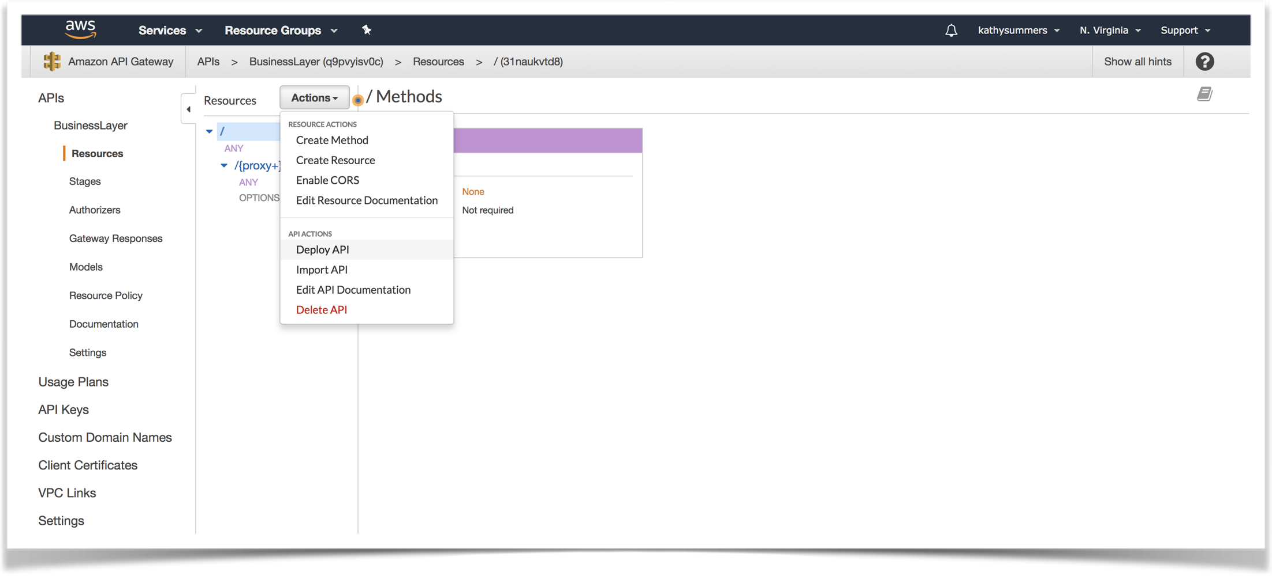
Deploy API

Slide 29
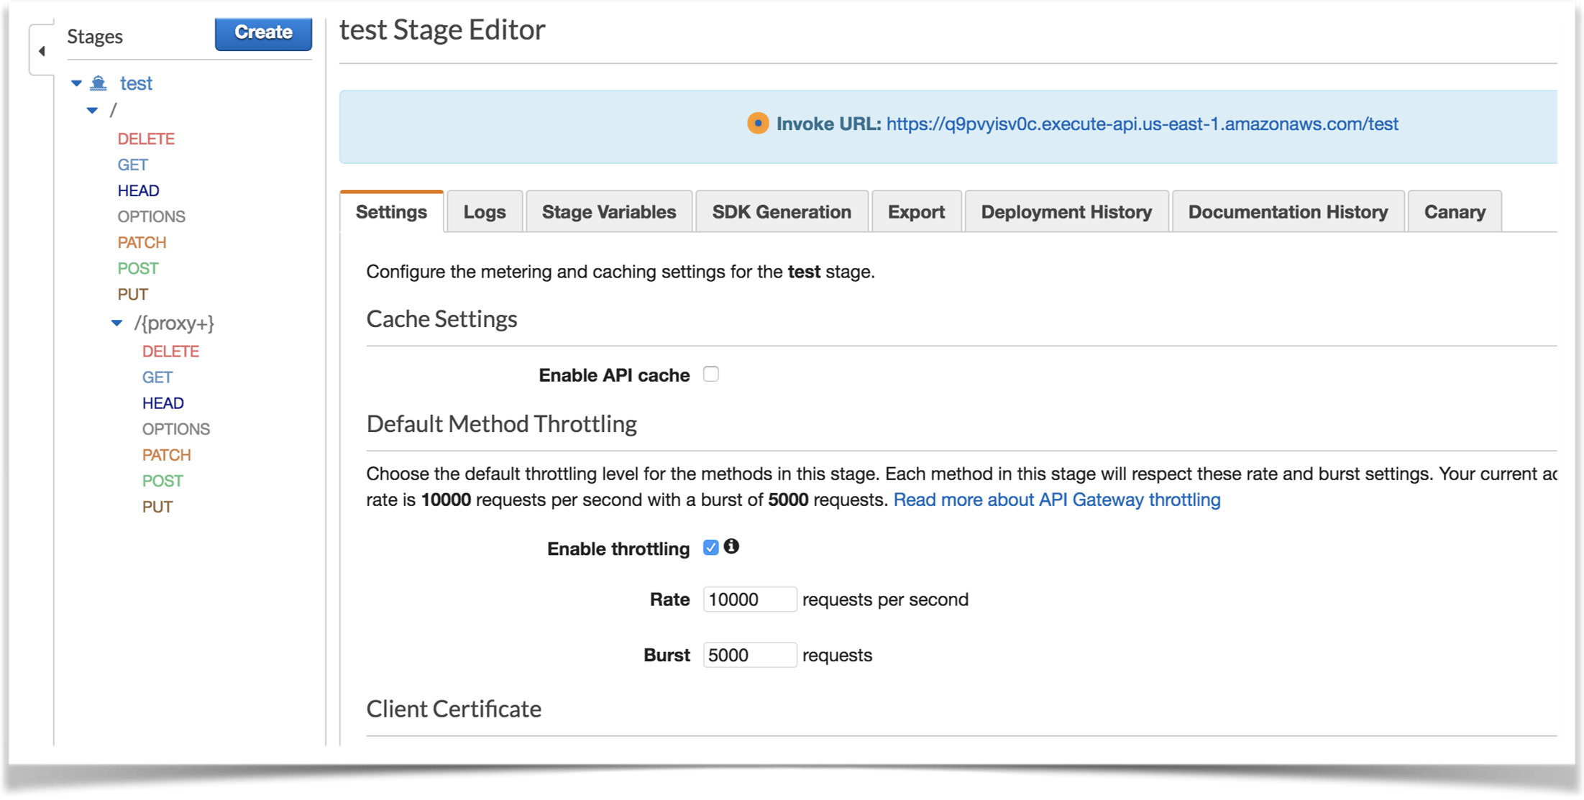

Slide 30
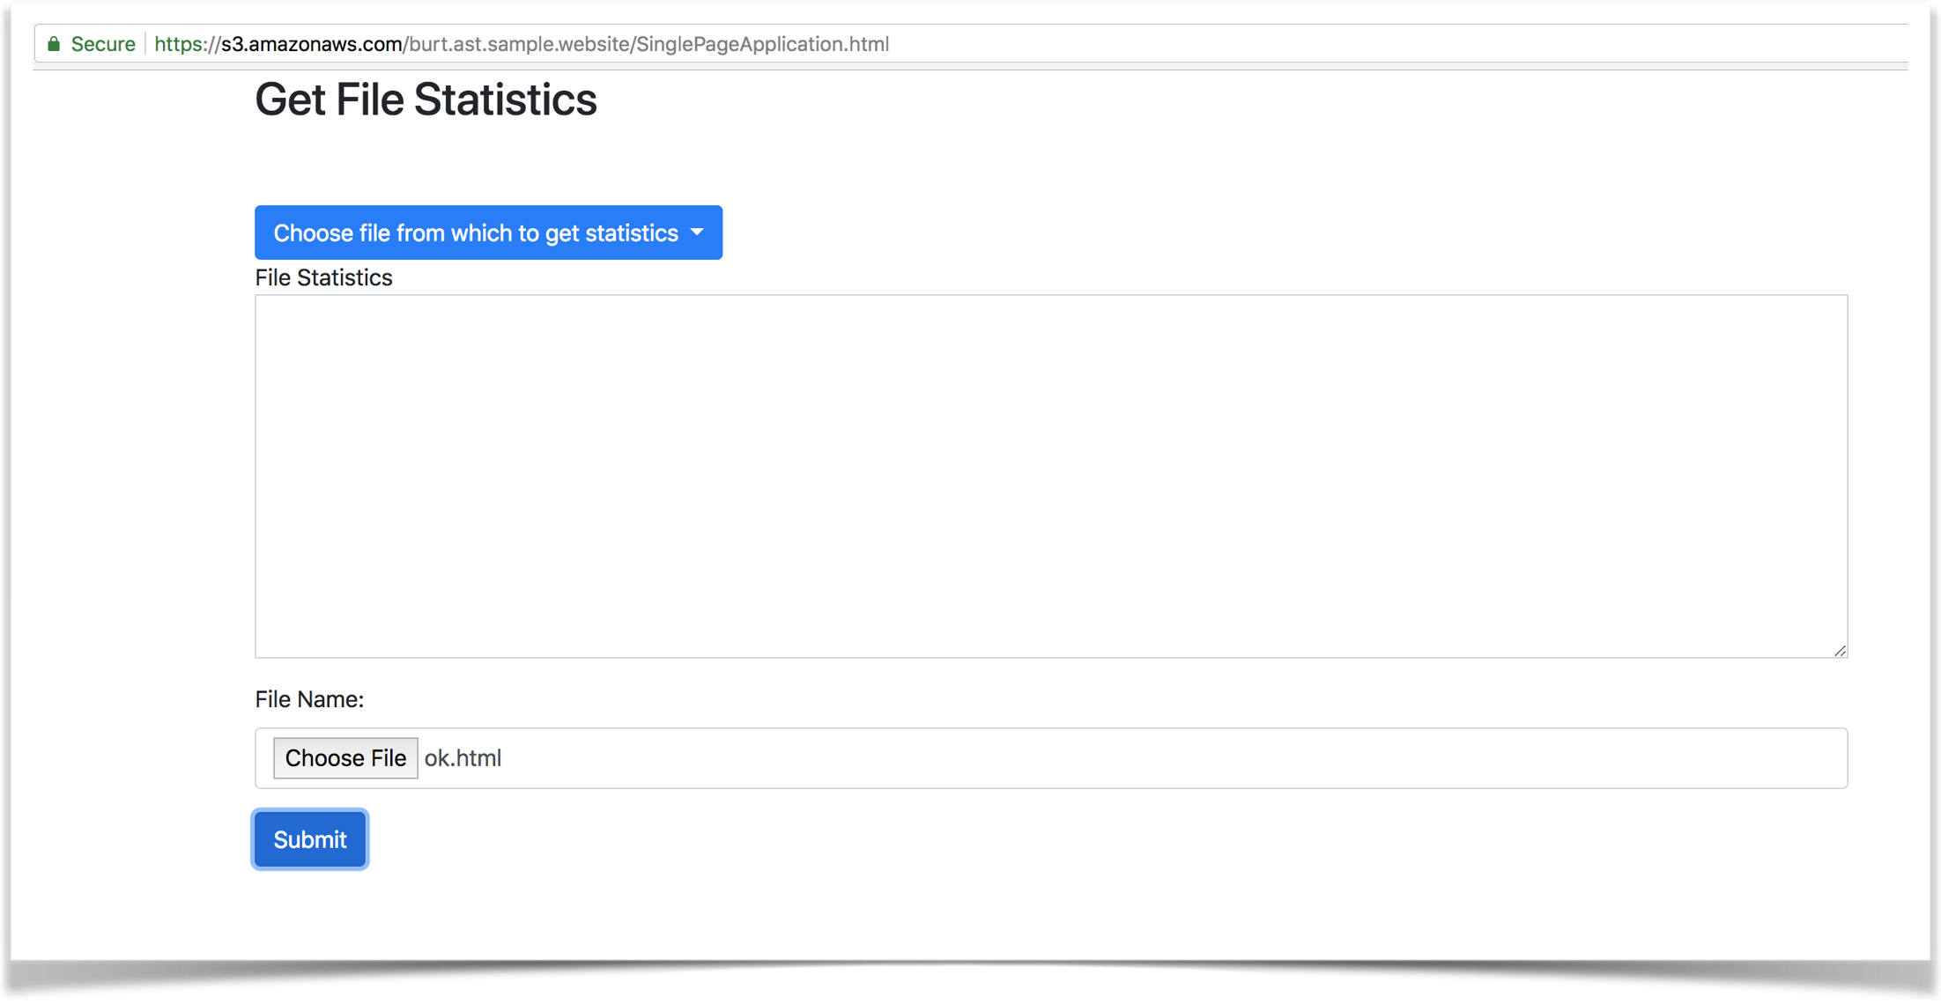

Slide 31
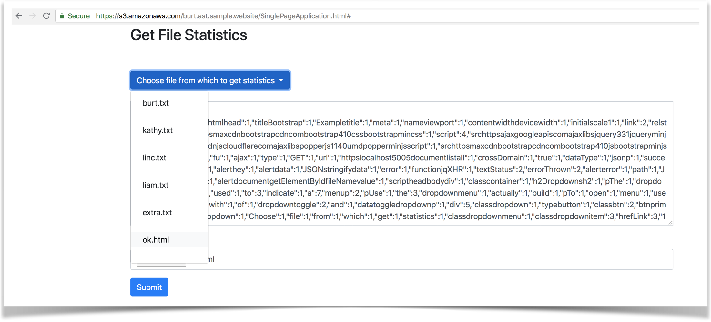
Lambda Function Results

Slide 32

Code Concepts Review
Async I/O driven by one thread which “fires and moves on”
You can chain code that is to be run when I/O is complete
Calls in the cloud are REST (Http based) calls
NOTE: There are frameworks to make async code cleaner

Slide 33
.NET Application Web API 2
.NET Web API for a REST API for the Business Layer
BusinessLayer also serves up the Single Page Application (SPA) html page. (Bad practice)
Helper to find word count in files (could be separate)

Slide 34
.NET Application Web API 2
DataAccessObject project which provides an interface to BusinessLayer to get stored files (Dictionary)
Could have many implementation of the DataAccessObject (could be injected)

Slide 35
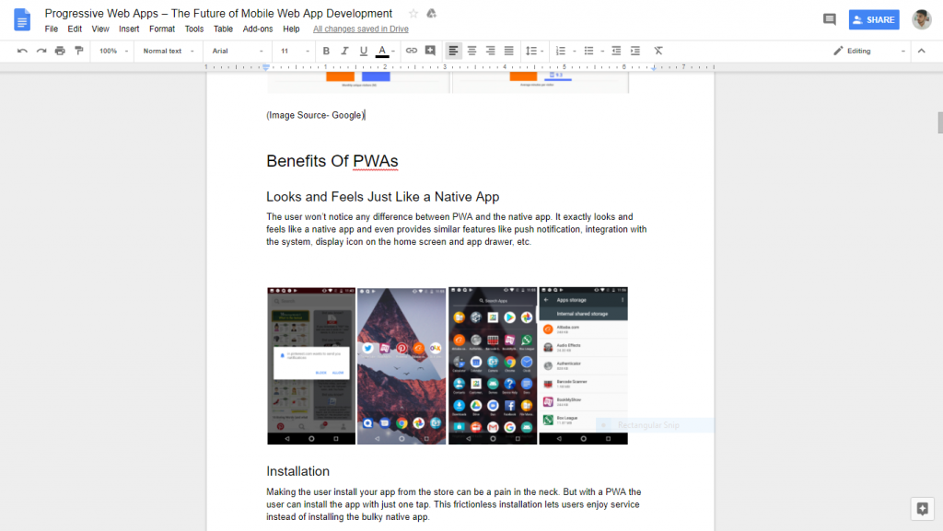
Single Page Application Example: Google Docs

Slide 36

Questions?
Burt Walsh
burt.walsh@ast.myflorida.com
Michael Avello
michael.avello@ast.myflorida.com
Agency For State Technology
4050 Esplanade Way, Suite 115
Tallahassee, Florida 32399

